Slide 1
Chef Lucas D Kiowski
The Iron Lions Solar Car Team
Co-Sponsor
12 years
Notes:
It’s the spring of 2012 and I’m in the second semester of my first year of teaching Culinary Arts…that’s Cooking you know! And there I am KILLING IT! Then outta nowhere my brother-in-law… Electronics teacher extraordinaire Joel Pitts says to me….”Hey I got this thing with these kids this summer. I need another chaperone…. you wont have to do anything. Wanna Come?” And that’s how it started for me….Now more than a Decade later I’ve had the privilege to be one of the Co-Sponsor of one of the Top High School Solar Car teams in the world… The Iron Lions… My name is Chef Lucas Kiowski let’s talk solar car strategy!

Slide 2
A Beginner’s Guide to Solar Car Racing Strategy
So, you built a Solar Car!
You passed Scrutineering!
Now What?

Slide 3
What Type of RACE is This?!?
A Track Race?
A Road Race?
Think More BASIC!

Slide 4
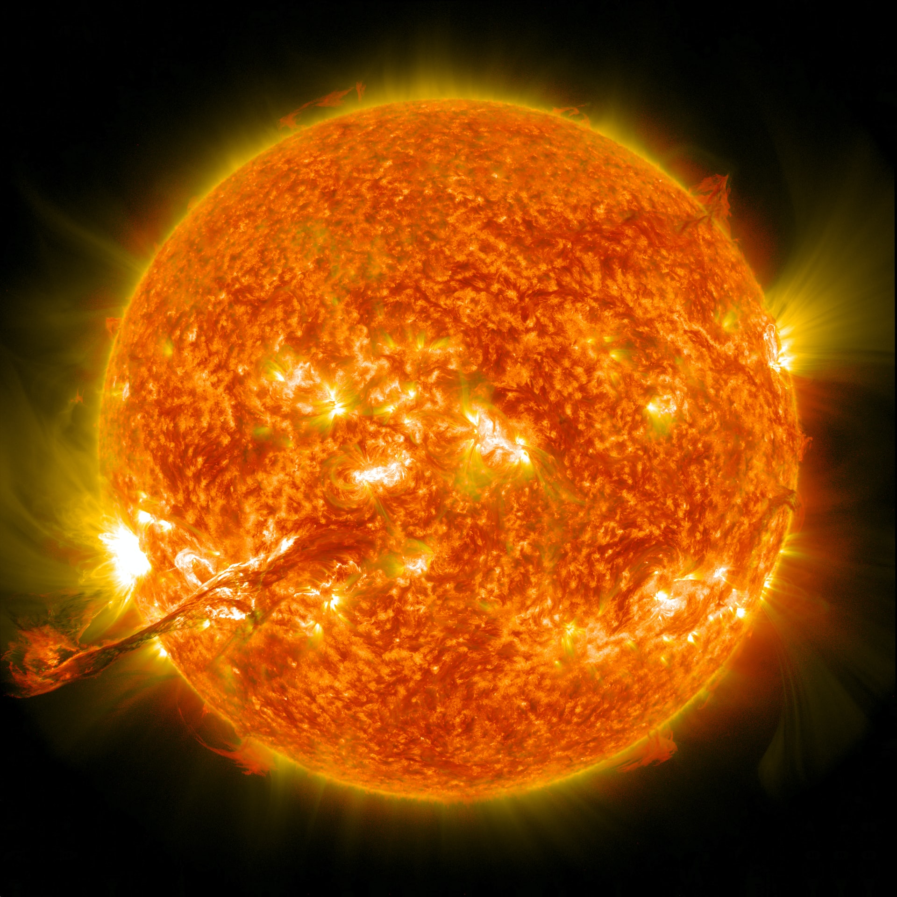
It’s a Solar Car Race!
It’s a Solar Car Race!
Photo by NASA on Unsplash

Slide 5
Name of the Game = Energy Management
Four types of Energy
The sun = Photons
Wiring = Electrons
Batteries = Chemical
Motor = Mechanical

Slide 6
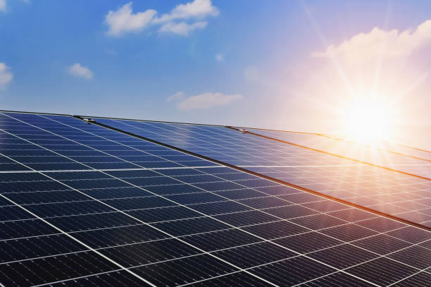
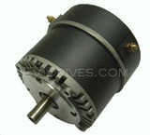
Basic Set-up
Yes there is an MPPT Here

Slide 7
Name of the Game = Energy Management
Four types of Energy
The sun = Photons
Wiring = Electrons
Batteries = Chemical
Motor = Mechanical
Essentially Every time you “Convert” Energy… Energy is wasted.
DO NOT WASTE ENERGY!

Slide 8
TWO Scenarios
100 Watts from the sun
Motor is demanding 200 Watts
200 Watts from the sun
Motor is demanding 100 Watts
100 w
200 w
100 w
100 w
100 w
What’s the THIRD Scenario?

Slide 9
It’s a Solar Car Race!
It’s a Solar Car Race!
Photo by NASA on Unsplash

Slide 10
Wasting Energy is a Solar Car SIN!
Driving on Less than what’s coming in
Driving with MPPT in Absorb, Float, or Rest
Full Battery During Race Time (9-5)
Depleting the Batteries More than you can Re-charge before the next Race Day
Finishing the last Race Day with any power left in the batteries (Remember Safety Cut offs)

Slide 11
The Nitty Gritty
Sun PLUS ???
Power you can Replace / Hours of Driving
Plus any charging during Race Hours
Monitor Energy INPUT / OUTPUT
Manage Accordingly

Slide 12
How to Measure / monitor Your Energy
Amps From MPPT (Panels)
Amps to Motor
Battery Voltage
Telemetry / Data Collection

Slide 13
Final Thoughts
Make a Plan
Work the Plan

Slide 15
Final Thoughts
Make a Plan
Work the Plan
Race your Race!

Slide 16
Questions?
Chef Lucas D. Kiowski
kiowskil@greenvilleisd.com

